Slide 1
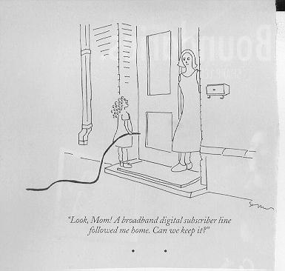
Application Layer
Dr. Shelly Heller
sheller@gwu.edu

Slide 2
Chapter 2: Application Layer
Chapter goals:
conceptual + implementation aspects of network application protocols
  client server paradigm
  service models
learn about protocols by examining popular application-level protocols
More chapter goals
specific protocols:
  http (RFC2616)
  ftp
  smtp (RFC 821)
  pop
  dns
programming network applications
  socket programming

Slide 3
Some Familiar Applications
e-mail
web
text messaging
remote login
P2P file sharing
multi-user network games
streaming stored video (YouTube, Hulu, Netflix)
voice over IP (e.g., Skype)
real-time video conferencing
social networking
search
…

Slide 4





Applications and application-layer protocols
Application: communicating, distributed processes
  running in network hosts in “user space”
  exchange messages to implement app
  e.g., email, file transfer, the Web
Application-layer protocols
  one “piece” of an app
  define messages exchanged by apps and actions taken
  user services provided by lower layer protocols
application
transport
network
data link
physical
application
transport
network
data link
physical
application
transport
network
data link
physical

Slide 5
Network applications: some jargon
A process is a program that is running within a host.
Within the same host, two processes communicate with interprocess communication defined by the OS.
Processes running in different hosts communicate with an application-layer protocol
A user agent is an interface between the user and the network application.
  Web:browser
  E-mail: mail reader
  streaming audio/video: media player

Slide 6
Client-server paradigm
Typical network app has two pieces: client and server
application
transport
network
data link
physical
Client:
initiates contact with server (“speaks first”)
typically requests service from server,
for Web, client is implemented in browser; for e-mail, in mail reader
Server:
provides requested service to client
e.g., Web server sends requested Web page, mail server delivers e-mail
request
reply
application
transport
network
data link
physical

Slide 7
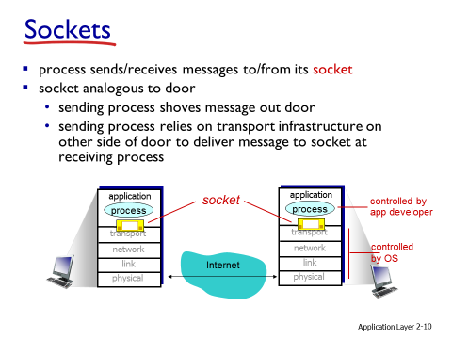
Sockets

Slide 8
to receive messages, process must have identifier
host device has unique 32-bit IP address
Q: does IP address of host on which process runs suffice for identifying the process?
  A: no, many processes can be running on same host
identifier includes both IP address and port numbers associated with process on host.
example port numbers:
  HTTP server: 80
  mail server: 25
to send HTTP message to gaia.cs.umass.edu web server:
  IP address: 128.119.245.12
  port number: 80

Slide 9
Application-layer protocols (cont).
API: application programming interface
defines interface between application and transport layer
socket: Internet API
  two processes communicate by sending data into socket, reading data out of socket
Q: how does a process “identify” the other process with which it wants to communicate?
  IP address of host running other process
  “port number” - allows receiving host to determine to which local process the message should be delivered
… lots more on this later.
Notes:
identifier includes both IP address and port numbers associated with process on host.
example port numbers:
HTTP server: 80
mail server: 25
to send HTTP message to gaia.cs.umass.edu web server:
IP address: 128.119.245.12
port number: 80
more shortly…
open protocols:
defined in RFCs
allows for interoperability
e.g., HTTP, SMTP
proprietary protocols:
e.g., Skype

Slide 10
What transport service does an app need?
Data loss
some apps (e.g., audio) can tolerate some loss
other apps (e.g., file transfer, telnet) require 100% reliable data transfer
Timing
some apps (e.g., Internet telephony, interactive games) require low delay to be “effective”
Bandwidth
some apps (e.g., multimedia) require minimum amount of bandwidth to be “effective”
other apps (“elastic apps”) make use of whatever bandwidth they get

Slide 11
Transport service requirements of common apps
Application
file transfer
e-mail
Web documents
real-time audio/video
stored audio/video
interactive games
financial apps
Data loss
no loss
no loss
loss-tolerant
loss-tolerant
loss-tolerant
loss-tolerant
no loss
Bandwidth
elastic
elastic
elastic
audio: 5Kb-1Mb
video:10Kb-5Mb
same as above
few Kbps up
elastic
Time Sensitive
no
no
no
yes, 100’s msec
yes, few secs
yes, 100’s msec
yes and no

Slide 12
Services provided by Internet transport protocols
TCP service:
connection-oriented: setup required between client, server
reliable transport between sending and receiving process
flow control: sender won’t overwhelm receiver
congestion control: throttle sender when network overloaded
does not providing: timing, minimum bandwidth guarantees
UDP service:
unreliable data transfer between sending and receiving process
does not provide: connection setup, reliability, flow control, congestion control, timing, or bandwidth guarantee
Q: why bother? Why is there a UDP?

Slide 13
Internet apps: their protocols and transport protocols
Application
layer protocol
smtp [RFC 821]
telnet [RFC 854]
http [RFC 2068]
ftp [RFC 959]
proprietary
(e.g. RealNetworks)
NSF
proprietary
(e.g., Vocaltec)
Underlying
transport protocol
TCP
TCP
TCP
TCP
TCP or UDP
TCP or UDP
typically UDP
Application
e-mail
remote terminal access
Web
file transfer
streaming multimedia
remote file server
Internet telephony

Slide 14
Security for TCP
TCP & UDP
no encryption
cleartext passwds sent into socket traverse Internet in cleartext
SSL
provides encrypted TCP connection
data integrity
end-point authentication
SSL is at app layer
apps use SSL libraries, that “talk” to TCP
SSL socket API
  cleartext passwords sent into socket traverse Internet encrypted
  see Chapter 8

Slide 15
The Web: some jargon
User agent for Web is called a browser:
  MS Internet Explorer
  Netscape Communicator
Server for Web is called Web server:
  Apache (public domain)
  MS Internet Information Server
Web page:
  consists of “objects”
  addressed by a URL
Most Web pages consist of:
  base HTML page, and
  several referenced objects.
URL has two components: host name and path name:
www.seas.gwu.edu/~sheller/pic.gif

Slide 16
The Web: the http protocol
http: hypertext transfer protocol
Web’s application layer protocol
client/server model
  client: browser that requests, receives, “displays” Web objects
  server: Web server sends objects in response to requests
http1.0: RFC 1945
http1.1: RFC 2068
http request
PC running
Explorer
http response
http request
Server
running
NCSA Web
server
http response
Mac running
Navigator

Slide 17
The http protocol: more
http: TCP transport service:
client initiates TCP connection (creates socket) to server, port 80
server accepts TCP connection from client
http messages (application-layer protocol messages) exchanged between browser (http client) and Web server (http server)
TCP connection closed
http is “stateless”
server maintains no information about past client requests
aside
Protocols that maintain “state” are complex!
past history (state) must be maintained
if server/client crashes, their views of “state” may be inconsistent, must be reconciled
Notes:
non-persistent HTTP
at most one object sent over TCP connection
connection then closed
downloading multiple objects required multiple connections
persistent HTTP
multiple objects can be sent over single TCP connection between client, server

Slide 18
http example - nonpersistent
Suppose user enters URL www.someSchool.edu/someDepartment/home.index
(contains text,
references to 10
jpeg images)
1a. http client initiates TCP connection to http server (process) at www.someSchool.edu. Port 80 is default for http server.
1b. http server at host www.someSchool.edu waiting for TCP connection at port 80. “accepts” connection, notifying client
2. http client sends http request message (containing URL) into TCP connection socket
3. http server receives request message, forms response message containing requested object (someDepartment/home.index), sends message into socket
time

Slide 19
http example (cont.)
4. http server closes TCP connection.
5. http client receives response message containing html file, displays html. Parsing html file, finds 10 referenced jpeg objects
6. Steps 1-5 repeated for each of 10 jpeg objects
time

Slide 20
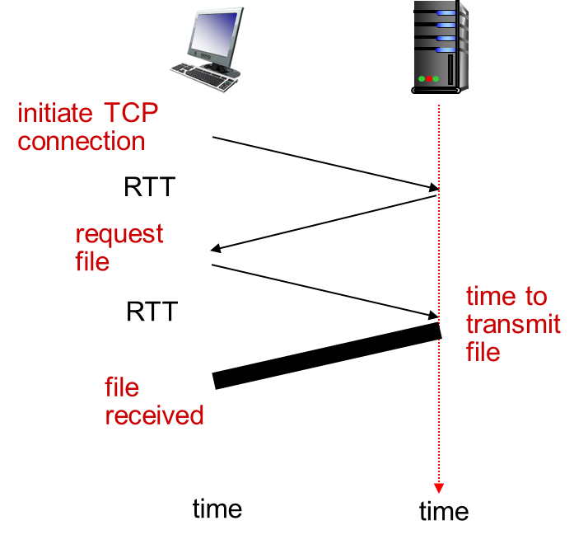
Non-persistent HTTP: response time
RTT (definition): time for a small packet to travel from client to server and back
HTTP response time:
one RTT to initiate TCP connection
one RTT for HTTP request and first few bytes of HTTP response to return
file transmission time
non-persistent HTTP response time =
  2RTT+ file transmission time

Slide 21
Non-persistent and persistent connections
Non-persistent
HTTP/1.0
server parses request, responds, and closes TCP connection
2 RTTs to fetch each object
Each object transfer suffers from slow start
Persistent
default for HTTP/1.1
on same TCP connection: server, parses request, responds, parses new request,..
Client sends requests for all referenced objects as soon as it receives base HTML.
Fewer RTTs and less slow start.
But most 1.0 browsers use
parallel TCP connections.

Slide 22
http message format: request
two types of http messages: request, response
http request message:
  ASCII (human-readable format)
request line
(GET, POST,
HEAD commands)
GET /somedir/page.html HTTP/1.0
User-agent: Mozilla/4.0
Accept: text/html, image/gif,image/jpeg
Accept-language:fr
(extra carriage return, line feed)
header
lines
Carriage return,
line feed
indicates end
of message

Slide 23

http request message: general format

Slide 24
http message format: response
status line
(protocol
status code
status phrase)
HTTP/1.0 200 OK
Date: Thu, 06 Aug 1998 12:00:15 GMT
Server: Apache/1.3.0 (Unix)
Last-Modified: Mon, 22 Jun 1998 …...
Content-Length: 6821
Content-Type: text/html
data data data data data ...
header
lines
data, e.g.,
requested
html file

Slide 25
http response status codes
In first line in server->client response message.
A few sample codes:
200 OK
  request succeeded, requested object later in this message
301 Moved Permanently
  requested object moved, new location specified later in this message (Location:)
400 Bad Request
  request message not understood by server
404 Not Found
  requested document not found on this server
505 HTTP Version Not Supported

Slide 26
Trying out http (client side) for yourself
1. Telnet to your favorite Web server:
telnet www.seas.gwu.edu 80
Opens TCP connection to port 80
(default http server port) at www.eecs.usma.edu.
Anything typed in sent
to port 80 at www.seas.gwu.edu
2. Type in a GET http request:
GET /~sheller/index.html HTTP/1.0
By typing this in (hit carriage
return twice), you send
this minimal (but complete)
GET request to http server
3. Look at response message sent by http server!

Slide 27
Response
sheller@hobbes.seas.gwu.edu:16: telnet www.seas.gwu.edu 80
Trying 128.164.156.41...
Connected to www.seas.gwu.edu.
Escape character is '^]'.
GET /~sheller/testpage.htm
<HTML>
<HEAD>
<META HTTP-EQUIV="Content-Type" CONTENT="text/html; charset=windows-1252">
<META NAME="Generator" CONTENT="Microsoft Word 97">
<TITLE>Test web page for cs183</TITLE>
</HEAD>
<BODY>
<FONT SIZE=2><P>Test web page for cs183</P>
<P>Nothing special on it</P>
</FONT></BODY>
</HTML>
Connection closed by foreign host.

Slide 28
sheller@hobbes.seas.gwu.edu:17: telnet www.seas.gwu.edu 80
Trying 128.164.156.41...
Connected to www.seas.gwu.edu.
Escape character is '^]'.
GET /~sheller/testpage.htm HTTP/1.0
HTTP/1.1 200 OK
Date: Mon, 03 Sep 2001 21:27:44 GMT
Server: Apache/1.3.20 (Unix) PHP/4.0.6
Last-Modified: Mon, 03 Sep 2001 20:20:40 GMT
ETag: "a06cb-130-3b93e618"
Accept-Ranges: bytes
Content-Length: 304
Connection: close
Content-Type: text/html
X-Pad: avoid browser bug
<HTML>
<HEAD>
<META HTTP-EQUIV="Content-Type" CONTENT="text/html; charset=windows- ETC

Slide 29
Cookies
four components:
  1) cookie header line of HTTP response message
  2) cookie header line in next HTTP request message
  3) cookie file kept on user’s host, managed by user’s browser
  4) back-end database at Web site
example:
Susan always access Internet from PC
visits specific e-commerce site for first time
when initial HTTP requests arrives at site, site creates:
  unique ID
  entry in backend database for ID

Slide 30
Cookies – more cookies
used for:
authorization
shopping carts
recommendations
user session state (Web e-mail)
how to keep “state”:
protocol endpoints: maintain state at sender/receiver over multiple transactions
cookies: http messages carry state
cookies and privacy:
cookies permit sites to learn a lot about you
you may supply name and e-mail to sites

Slide 31
User-server interaction: authentication
client
server
Authentication goal: control access to server documents
stateless: client must present authorization in each request
authorization: typically name, password
  authorization: header line in request
  if no authorization presented, server refuses access, sends
    WWW authenticate:
    header line in response
usual http request msg
401: authorization req.
WWW authenticate:
usual http request msg
+ Authorization:line
usual http response msg
usual http request msg
+ Authorization:line
usual http response msg
time
Browser caches name & password so
that user does not have to repeatedly enter it.

Slide 32
User-server interaction: cookies
client
server
server sends “cookie” to client in response msg
  Set-cookie: 1678453
client presents cookie in later requests
  cookie: 1678453
server matches presented-cookie with server-stored info
  authentication
  remembering user preferences, previous choices
usual http request msg
usual http response +
Set-cookie: #
usual http request msg
cookie: #
cookie-
specific-
action
usual http response msg
usual http request msg
cookie: #
cookie-
specific-
action
usual http response msg

Slide 33
pluto693098079|0|fastclick.net/0163778521629577354298050515229432513*c4932127996695377:408:1||||||||||fastclick.net/0248963852829435532298060515229432513*oatmeal284:2127:5060:1:0:99669377|||||||||||||||fastclick.net/02783392002943855029807051432513*
MC1V=2&GUID=8E167361B54745F2A57B2F803D2E4020msn.com/0304938803229592233351446004829431287*mhMSFTmsn.com/0252739686429798416352047004829431287*
CPIDAG00000000148531020centrport.net/026847313923152044818357828829433472*

Slide 34
User-server interaction: conditional GET
client
server
Goal: don’t send object if client has up-to-date stored (cached) version
client: specify date of cached copy in http request
  If-modified-since: <date>
server: response contains no object if cached copy up-to-date:
  HTTP/1.0 304 Not Modified
http request msg
If-modified-since: <date>
object
not
modified
http response
HTTP/1.0
304 Not Modified
http request msg
If-modified-since: <date>
object
modified
http response
HTTP/1.1 200 OK
…
<data>

Slide 35
Web Caches (proxy server)
Goal: satisfy client request without involving origin server
user sets browser: Web accesses via web cache
client sends all http requests to web cache
  if object at web cache, web cache immediately returns object in http response
  else requests object from origin server, then returns http response to client
origin
server
Proxy
server
http request
http request
client
http response
http response
http request
http request
http response
http response
client
origin
server

Slide 36
Why Web Caching?
origin
servers
Assume: cache is “close” to client (e.g., in same network)
smaller response time: cache “closer” to client
decrease traffic to distant servers
  link out of institutional/local ISP network often bottleneck
public
Internet
1.5 Mbps
access link
institutional
network
10 Mbps LAN
institutional
cache
Notes:
cookies and privacy:
cookies permit sites to learn a lot about you
you may supply name and e-mail to sites
why Web caching?
reduce response time for client request
reduce traffic on an institution’s access link
Internet dense with caches: enables “poor” content providers to effectively deliver content (so too does P2P file sharing)

Slide 37
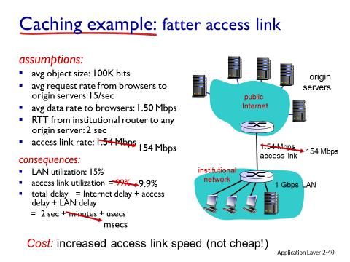

Slide 38
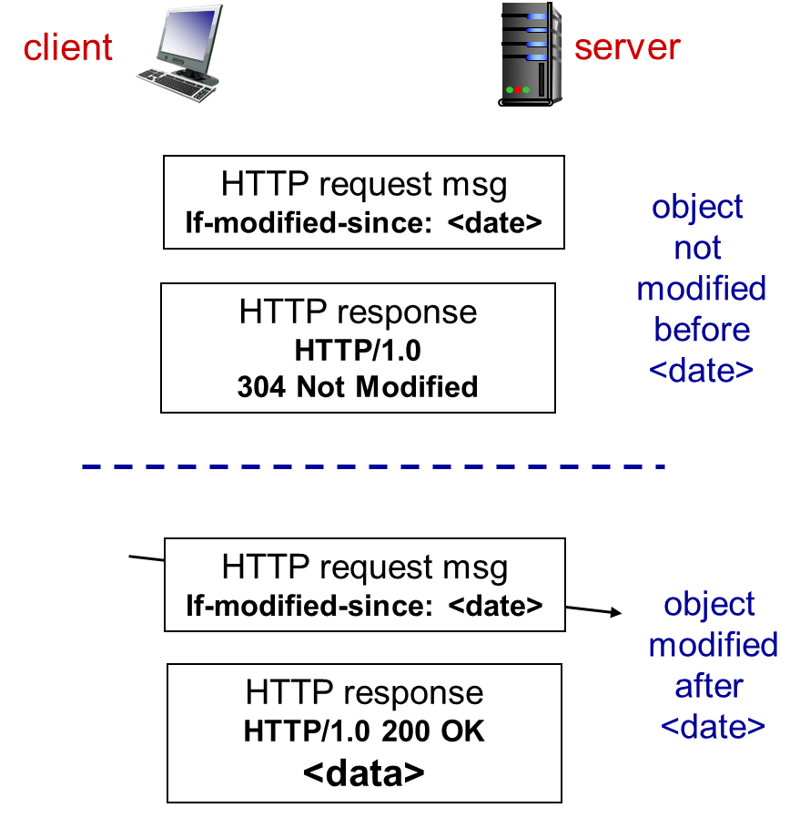
Conditional GET
Goal: don’t send object if cache has up-to-date cached version
  no object transmission delay
  lower link utilization
cache: specify date of cached copy in HTTP request
  If-modified-since: <date>
server: response contains no object if cached copy is up-to-date:
  HTTP/1.0 304 Not Modified

Slide 39

ftp: the file transfer protocol
FTP
user
interface
FTP
client
file transfer
FTP
server
user
at host
local file
system
remote file
system
transfer file to/from remote host
client/server model
  client: side that initiates transfer (either to/from remote)
  server: remote host
ftp: RFC 959
ftp server: port 21

Slide 40
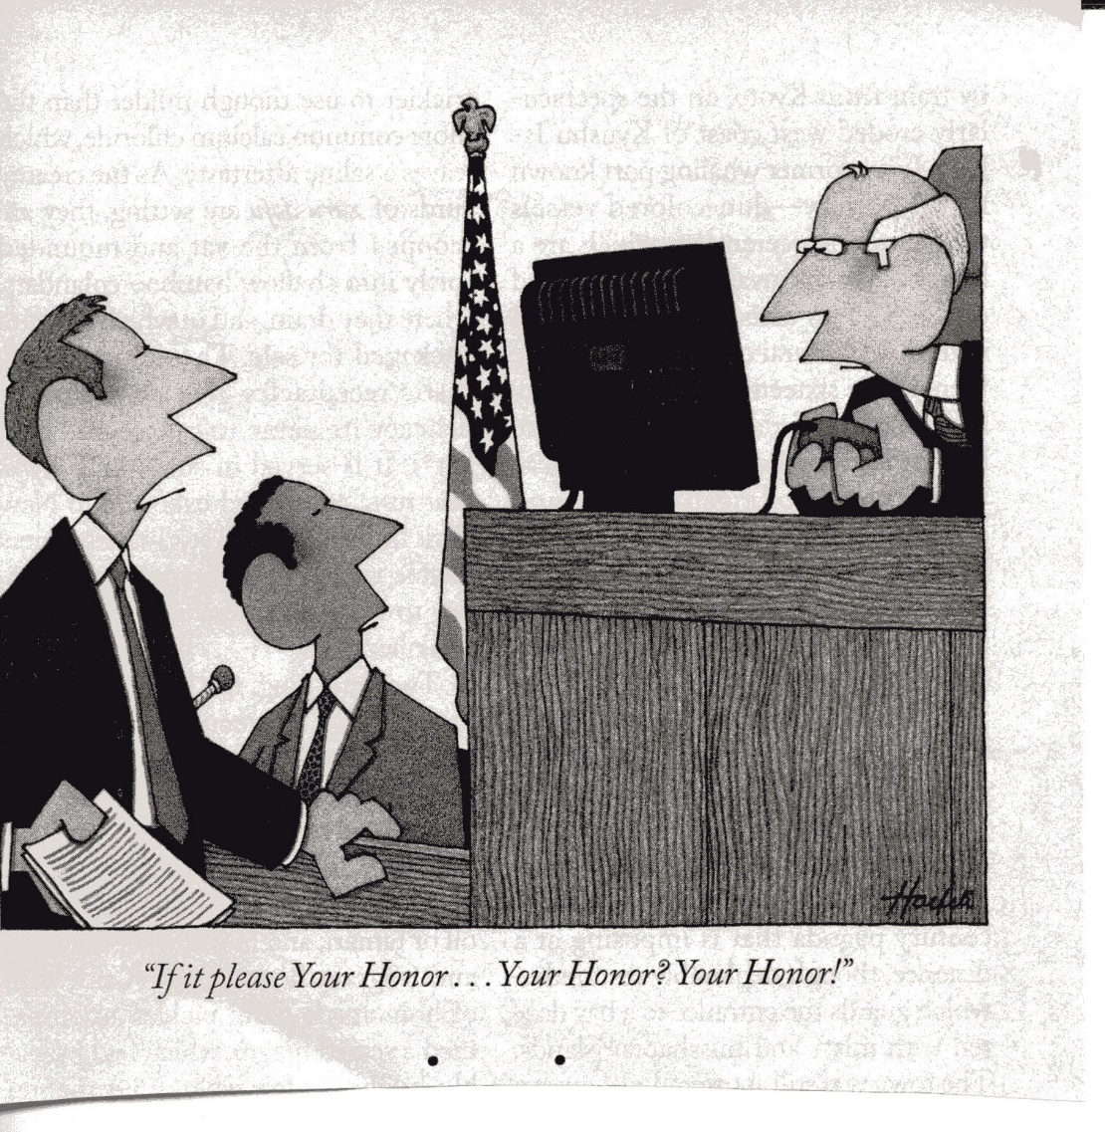

Slide 41
ftp: separate control, data connections
ftp client contacts ftp server at port 21, specifying TCP as transport protocol
two parallel TCP connections opened:
  control: exchange commands, responses between client, server.
    “out of band control”
  data: file data to/from server
ftp server maintains “state”: current directory, earlier authentication
TCP control connection
port 21
FTP
client
TCP data connection
port 20
FTP
server

Slide 42
ftp commands, responses
Sample commands:
sent as ASCII text over control channel
USER username
PASS password
LIST return list of file in current directory
RETR filename retrieves (gets) file
STOR filename stores (puts) file onto remote host
Sample return codes
status code and phrase (as in http)
331 Username OK, password required
125 data connection already open; transfer starting
425 Can’t open data connection
452 Error writing file

Slide 43
Start up Wireshark
Start up your web browser.
Start up the Wireshark packet sniffer
Enter “http” (just the letters, not the quotation marks) in the
display-filter-specification window, so that only captured HTTP
messages will be displayed later in the packet-listing window.
Wait a bit more than one minute and then begin
Wireshark packet capture.
Enter the following to your browser
http://gaia.cs.umass.edu/wireshark-labs/HTTP-wireshark-file1.html
Your browser should display the very simple, one-line HTML file.
Stop Wireshark packet capture.

Slide 44
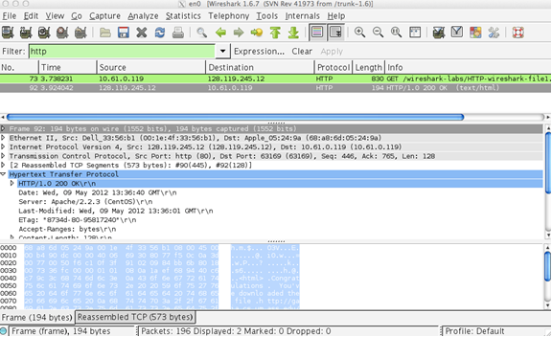
Wireshark Reply Looks like this

Slide 45
What to Find Using Wireshark
By looking at the information in the HTTP GET and response messages, answer the following questions.
Is your browser running HTTP version 1.0 or 1.1? What version of HTTP is the server running?
What languages (if any) does your browser indicate that it can accept to the server?
What is the IP address of your computer? Of the gaia.cs.umass.edu server?
What is the status code returned from the server to your browser?
are not displayed in the packet-listing window? If so, name one.

Slide 46
And
When was the HTML file that you are retrieving last modified at the server?
How many bytes of content are being returned to your browser?
By inspecting the raw data in the packet content window, do you see any headers within the data that

Slide 47
Wait – there is more – What about Caching
Start up your web browser, clear browser’s cache
Start up the Wireshark packet sniffer
Enter the following URL into your browser
http://gaia.cs.umass.edu/wireshark-labs/HTTP-wireshark-file2.html - You should just see a five line file
Quickly enter the same URL into your browser again (or simply select the refresh button on your browser)
Stop Wireshark packet capture, and enter “http” in the display-filter-specification window, so that only captured HTTP messages will be displayed later in the packet-listing window.

Slide 48
What to find
Inspect the contents of the first HTTP GET request from your browser to the server. Do you see an “IF-MODIFIED-SINCE” line in the HTTP GET?
Inspect the contents of the server response. Did the server explicitly return the contents of the file? How can you tell?
Now inspect the contents of the second HTTP GET request from your browser to the server. Do you see an “IF-MODIFIED-SINCE:” line in the HTTP GET? If so, what information follows the “IF-MODIFIED-SINCE:” header?

Slide 49
And Last for tonight
What is the HTTP status code and phrase returned from the server in response to this second HTTP GET? Did the server explicitly return the contents of the file? Explain.
For homework you will finish this exercise – it will be emailed to you. Due Next class

